Slide 1
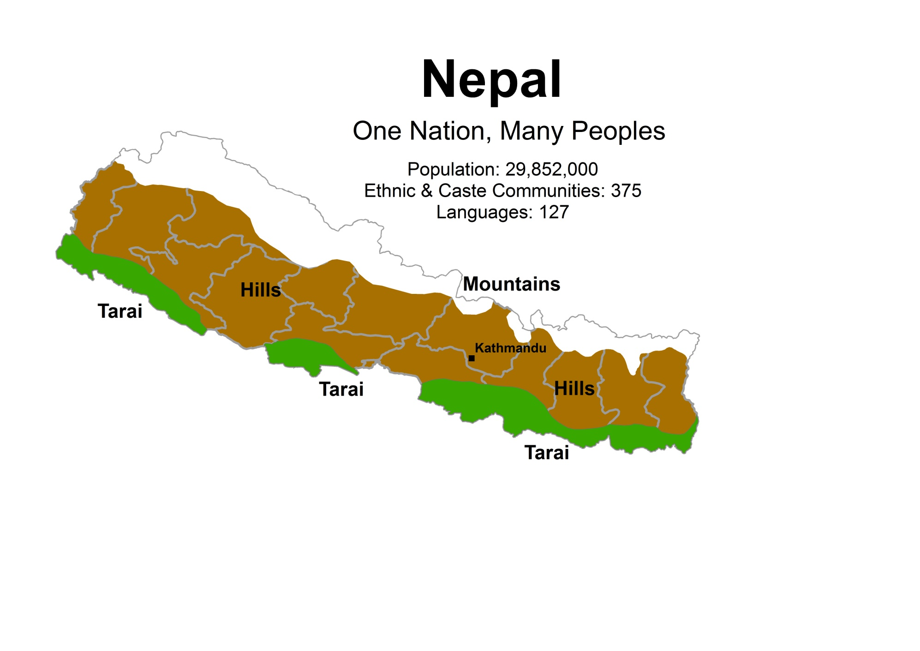

Slide 2
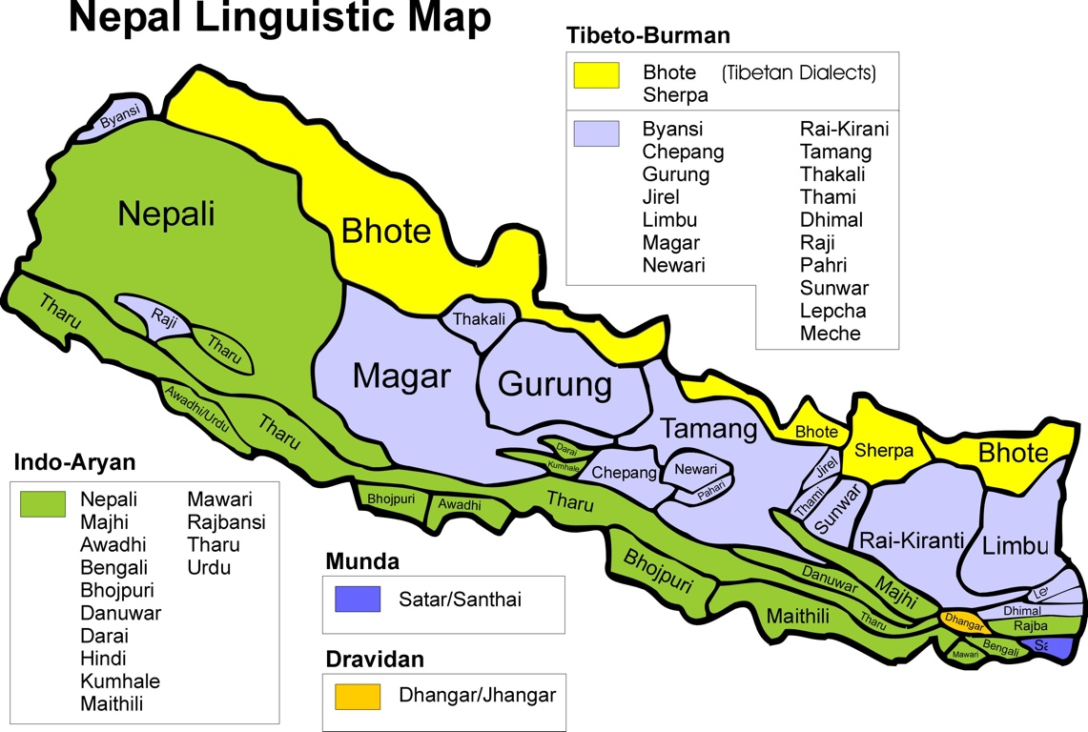

Slide 3
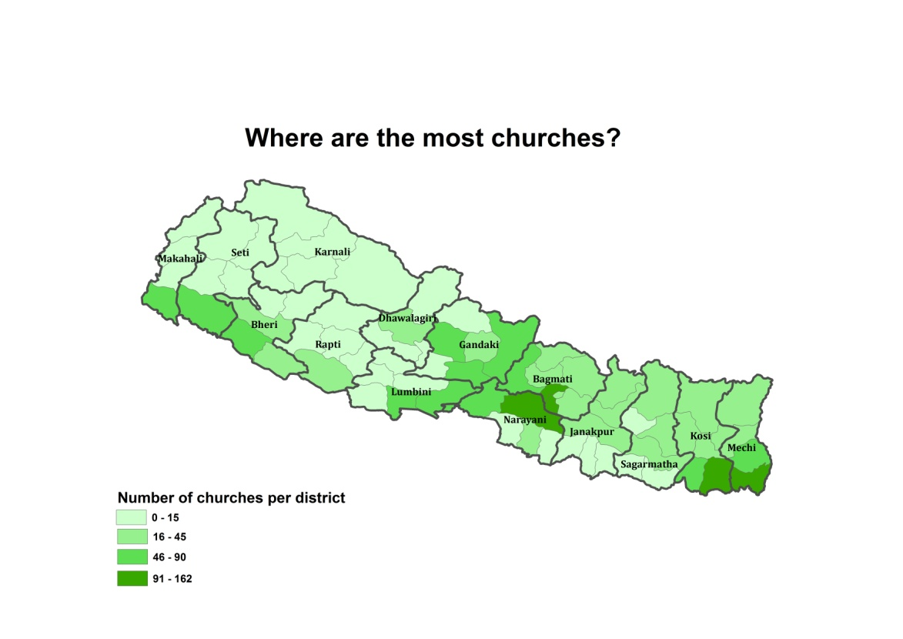
Church Distribution

Slide 4
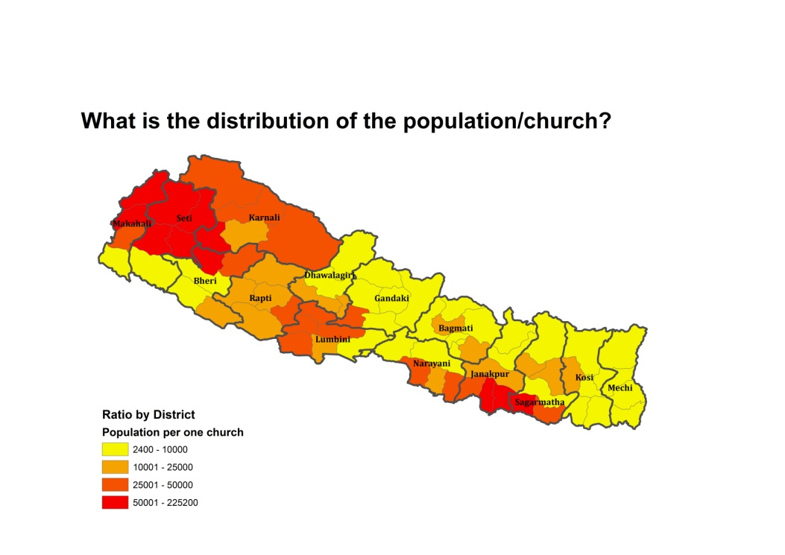
Ratio of Population/Church

Slide 5
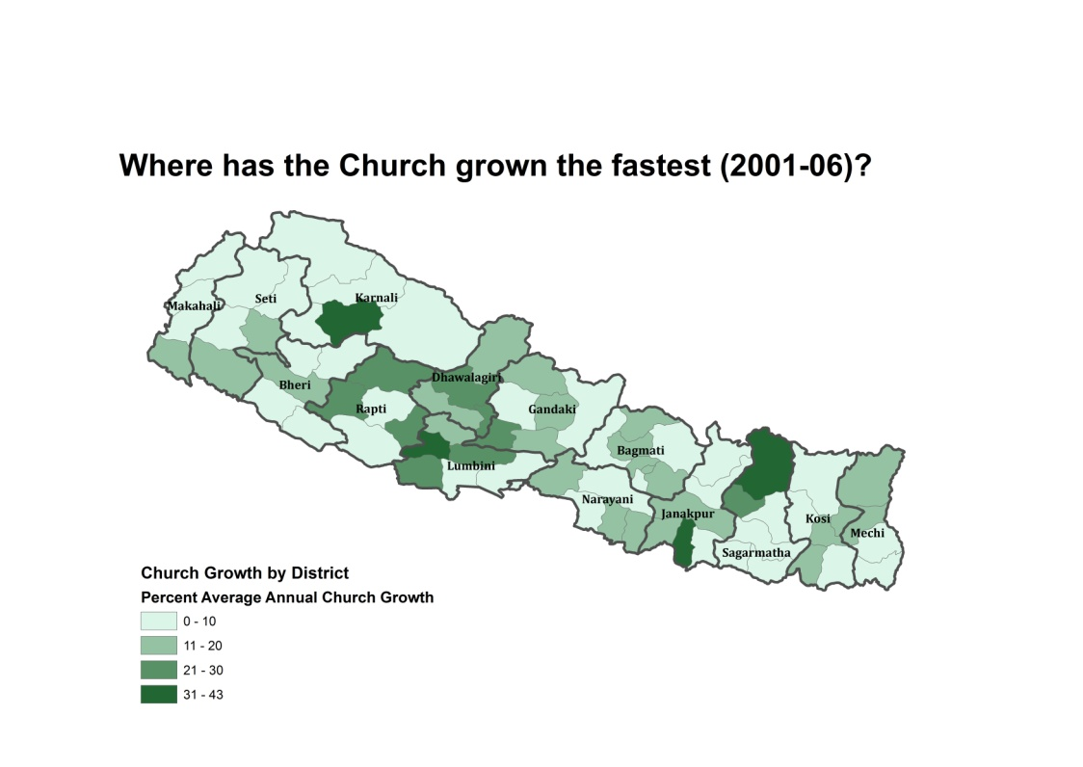
Church Growth snapshot

Slide 6
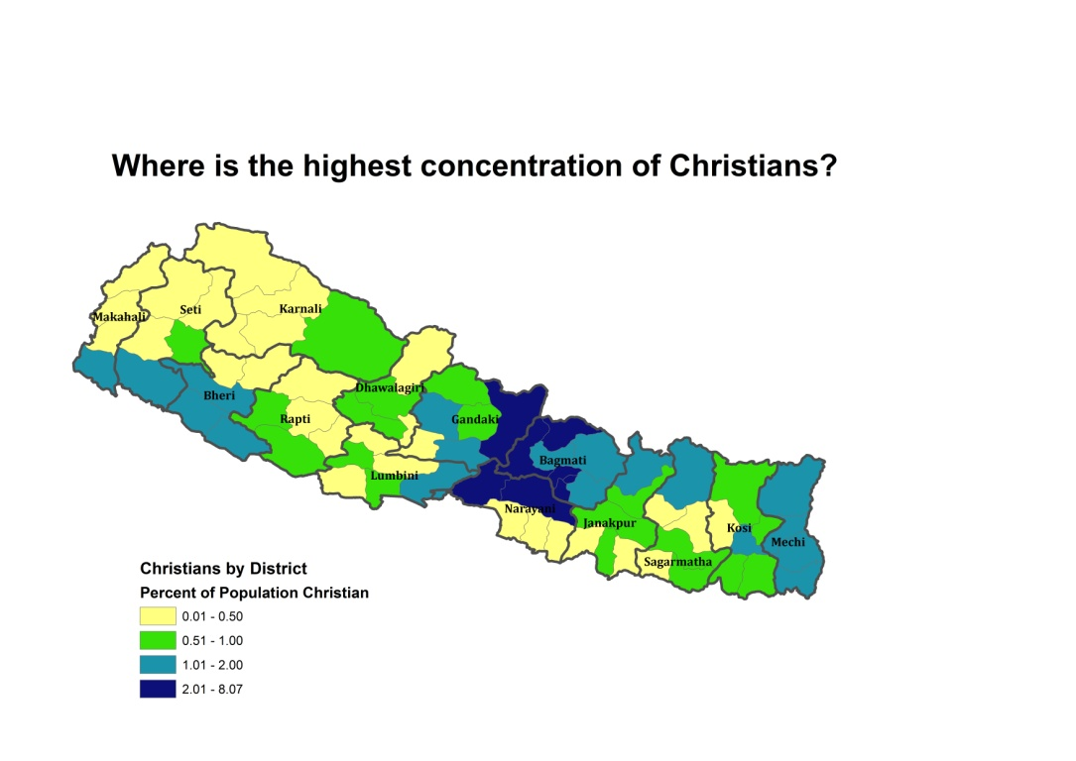
Christian Presence

Slide 7
Nepal Church Research
Data Sources
East Nepal DAWN Survey – 2005
Nepal DAWN National Survey – 2007
Nepal Population Census, 2001
Joshua Project, 2010 Peoples Information
OMID South Asian Peoples Research 2010
Operation World, 2010

